Slide 1
Project 2
Sandesh Poudel

Slide 2
About our Project
We want to show World Cup match scores and match statistics in a same page.
We want to combine the two and display them for the user so that they can keep up to date with the world cup.

Slide 3
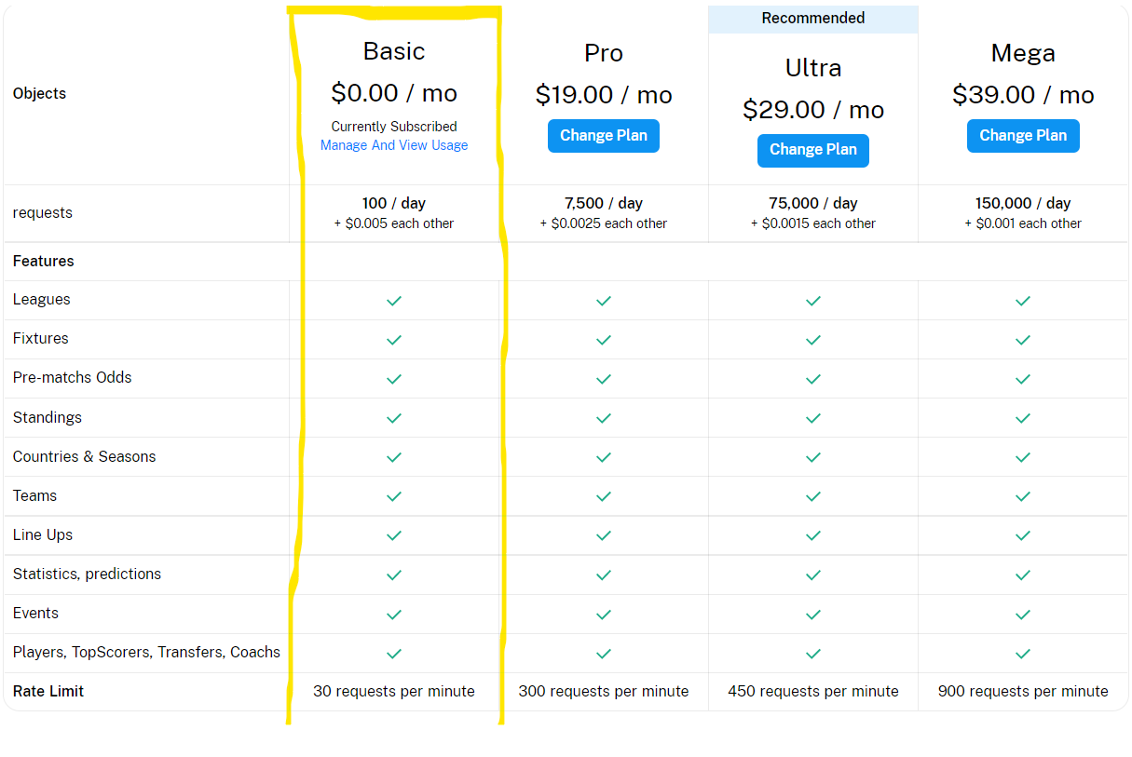
DataSource:
We are using API source from rapidapi.com. The website has free subscription for limited API calls. Our free plan gives us 100 API calls per day with 30 requests per minute.

Slide 4
Authentication for API calls:
We need to register either in rapidapi.com or https://www.api-football.com/ for API key. The API is configured to work only with GET requests with following header when accessing through rapidapi.com:
'X-RapidAPI-Key', 'XxXxXxXxXxXxXxXxXxXxXxXxXxXxXx');
'X-RapidAPI-Host', "api-football-v1.p.rapidapi.com");

Slide 5
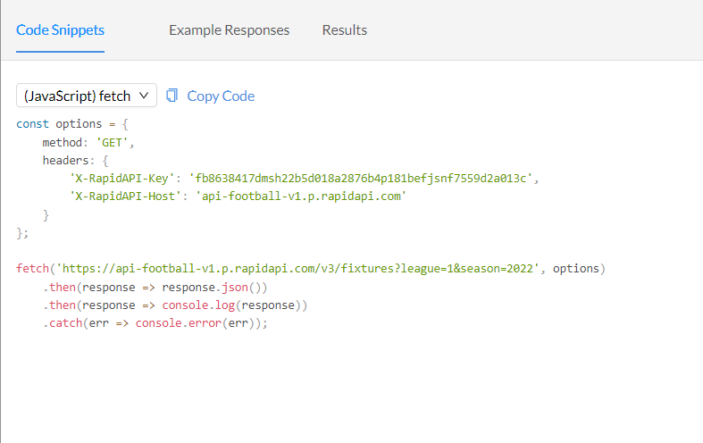
Code Snippet:
This is the sample code snipped provided by our source website using javascript fetch and get method.

Slide 6
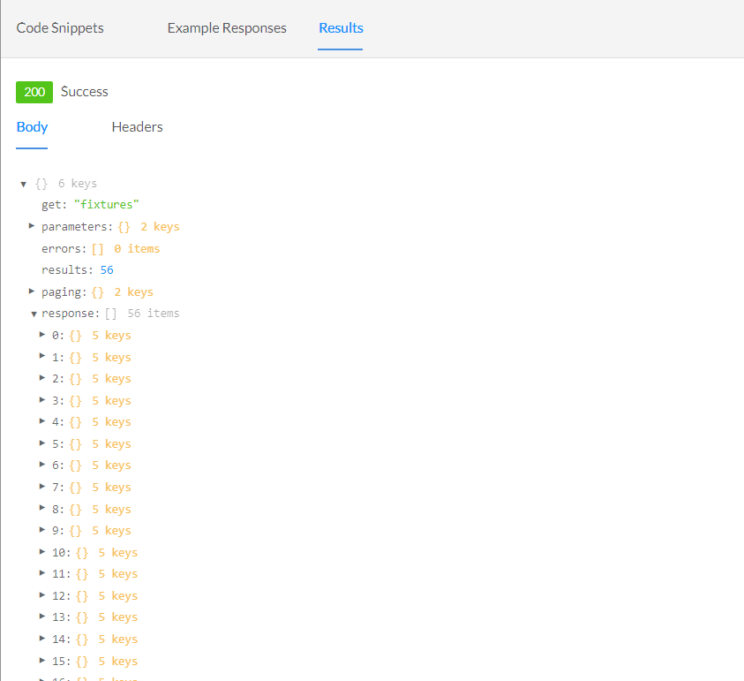
Results:
Running the snippet with minimal/no parameters provides us the following results with the required results in response field.

Slide 7
Endpoints:
These are the endpoints that are available through the API provider:
Timezone
Countries
Leagues
Teams
Venues
Standings
Fixtures : Get lists of all Soccer matches based on several parameters.

Slide 8
Injuries
Predictions
Statistics : Get statistics of a particular fixture based on fixture id.
Coachs
Players
Transfers
Trophies
Sidelined
Odds(In-play)
Odds(Pre-match

Slide 9
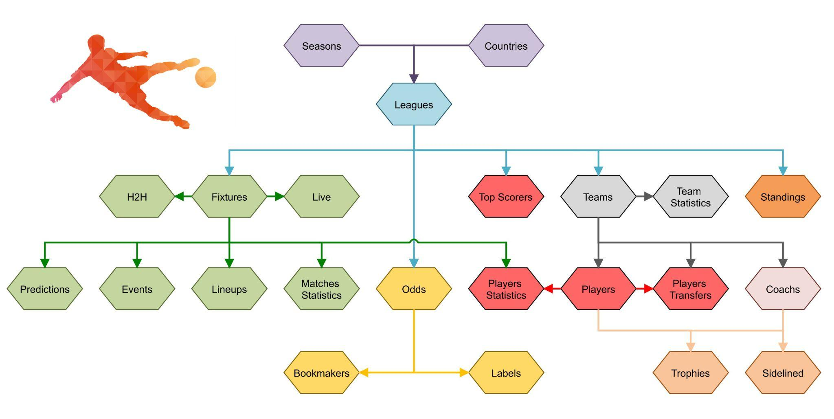
Architecture:

Slide 10
Live Code Snippet Demo:
https://rapidapi.com/api-sports/api/api-football

Slide 11
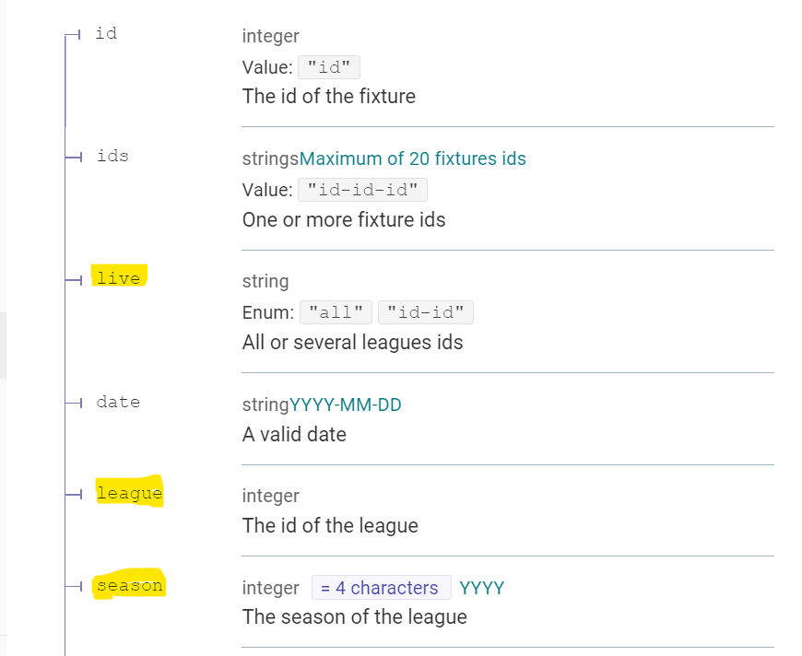
Fixture Parameters:

Slide 12
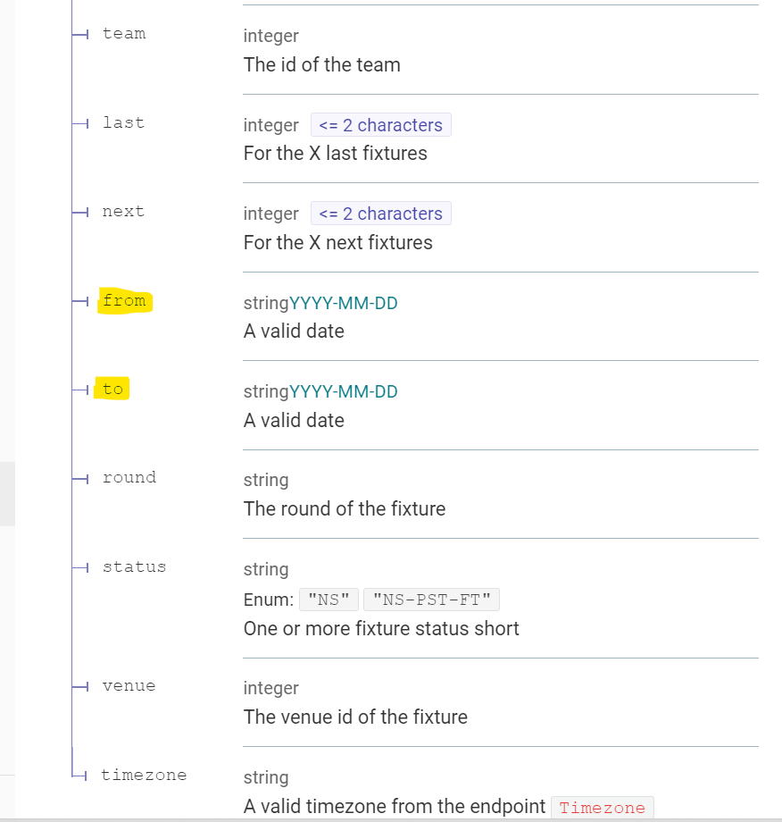

Slide 13
The “live” parameter cannot be used with date parameters., but can be used with “season” and “league” parameters.
Update Frequency : This endpoint is updated every 15 seconds.
Recommended Calls : 1 call per minute for the leagues, teams, fixtures who have at least one fixture in progress otherwise 1 call per day.

Slide 14
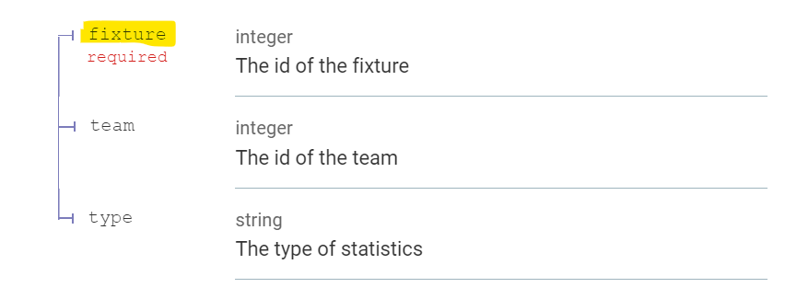
Statistics Parameter

Slide 15
We will only be using fixture id to get statistics. And fixture id can be accessed through Fixture endpoint.
Update Frequency : This endpoint is updated every minute.
Recommended Calls : 1 call every minute for the teams or fixtures who have at least one fixture in progress otherwise 1 call per day.

Slide 16
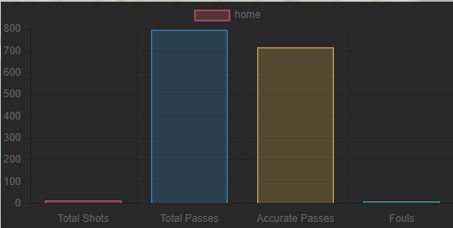
Libraries
Chartjs
We use chart.js to display the statistics of matches with bar graphs.

Slide 17
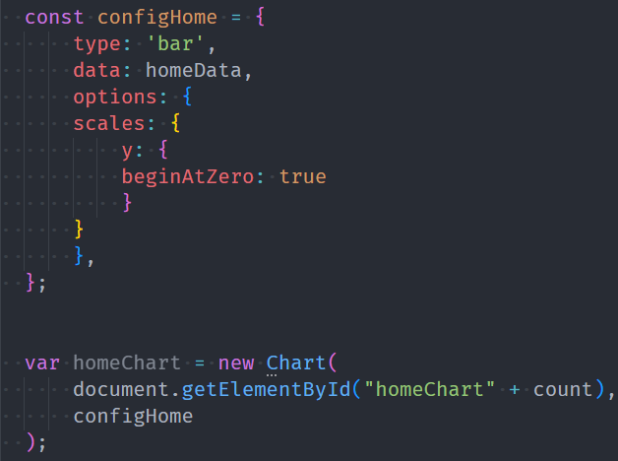
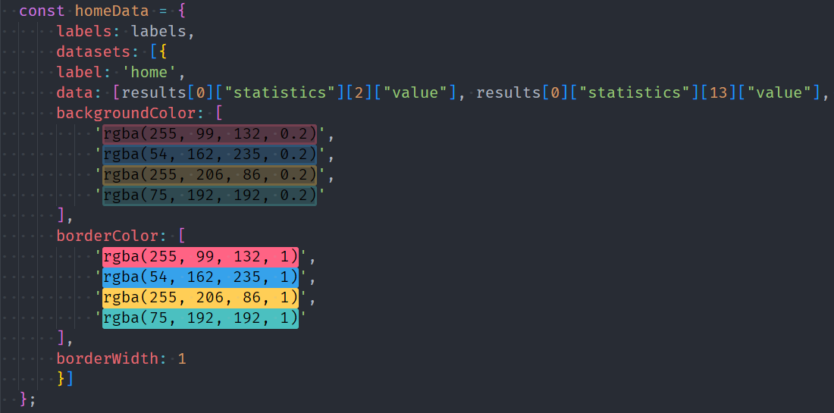

Slide 18
Live Demo

Slide 19
Citations
https://www.api-football.com/documentation-v3#section/Authentication/API-SPORTS-Account

